Slide 1
Naïve Bayes
What is naïve bayes?
Naive Bayes classifier is a straightforward and powerful algorithm for the classification task in machine learning. Even if we are working on a data set with millions of records with some attributes, it is suggested to try Naive Bayes approach.
Naive Bayes classifier gives great results when we use it for textual data analysis. Such as Natural Language Processing.
To understand the naive Bayes classifier we need to understand the Bayes theorem. So let’s first discuss the Bayes Theorem.
At first you have to know:
What is probability?
What is conditional probability?

Slide 2
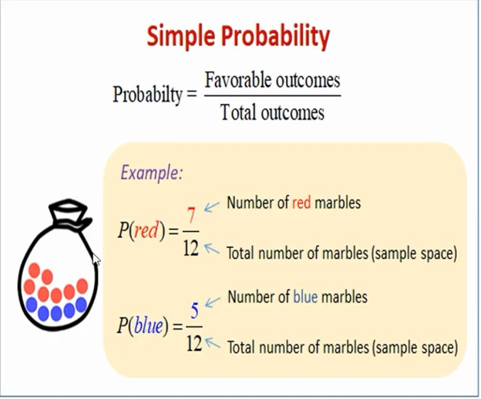
Naïve Bayes
What is probability?

Slide 3
Naïve Bayes
What is conditional probability?
In probability theory, conditional probability is a measure of the probability of an event occurring, given that another event has already occurred.
Conditional probability formula is: P(A | B) = P(A ∩ B) / P(B)
Example: If you roll a dice what is probability to get 5 if no chance to get any even number?
Solution: Since, here given a condition no chance to get any even number and we know a dice contain 1 to 6 numbers, now if we remove the even number then remaining number will be 1, 3, 5. Now, to for getting 5 probability will be 1/3 = 0.33%.

Slide 4
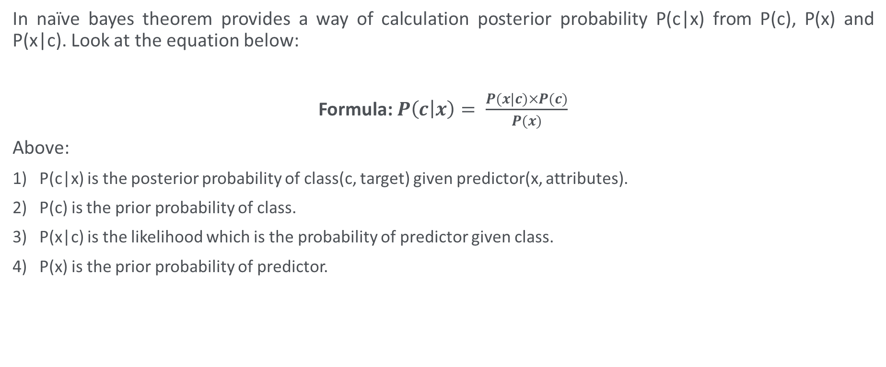
Naïve Bayes
In naïve bayes theorem provides a way of calculation posterior probability P(c|x) from P(c), P(x) and P(x|c). Look at the equation below:
Formula: $P\left(c | x\right)= \frac{P(x|c)×P(c)}{P(x)}$
Above:
P(c|x) is the posterior probability of class(c, target) given predictor(x, attributes).
P(c) is the prior probability of class.
P(x|c) is the likelihood which is the probability of predictor given class.
P(x) is the prior probability of predictor.

Slide 5
Naïve Bayes
What Is a Posterior Probability?
A posterior probability, in Bayesian statistics, is the revised or updated probability of an event occurring after taking into consideration new information. The posterior probability is calculated by updating the prior probability using Bayes' theorem. In statistical terms, the posterior probability is the probability of event A occurring given that event B has occurred.
What Is Prior Probability?
Prior probability, in Bayesian statistical inference, is the probability of an event before new data is collected. This is the best rational assessment of the probability of an outcome based on the current knowledge before an experiment is performed.
What is likelihood?
Likelihood function is a fundamental concept in statistical inference. It indicates how likely a particular population is to produce an observed sample.

Slide 6

Naïve Bayes

Slide 7
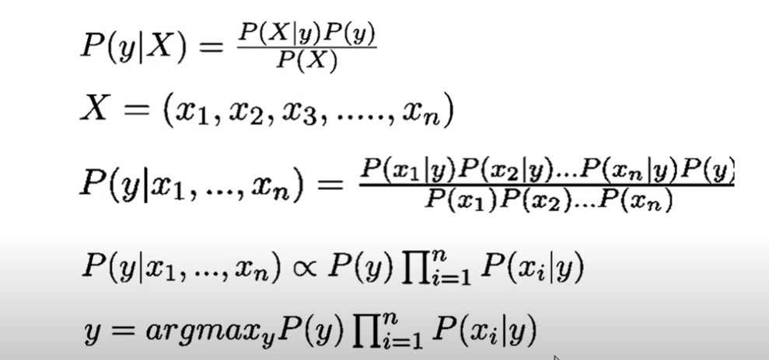
Naïve Bayes

Slide 8
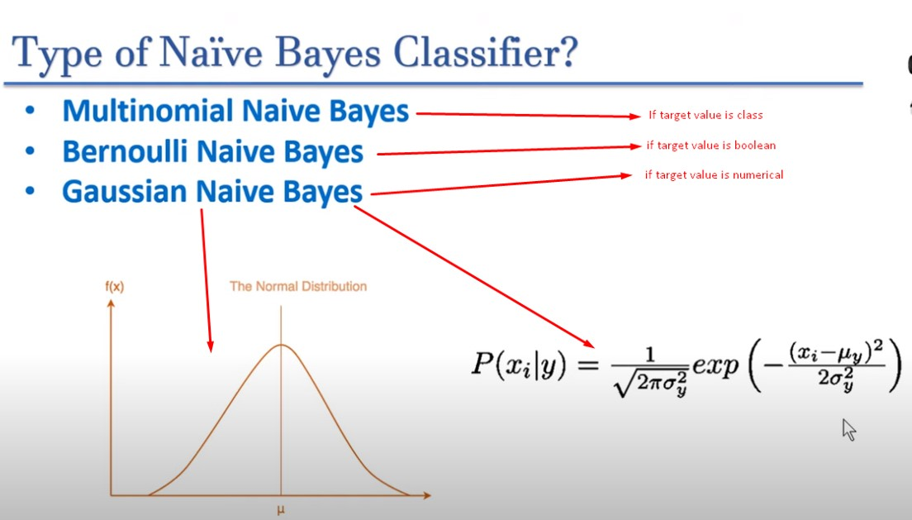
Naïve Bayes

Slide 9
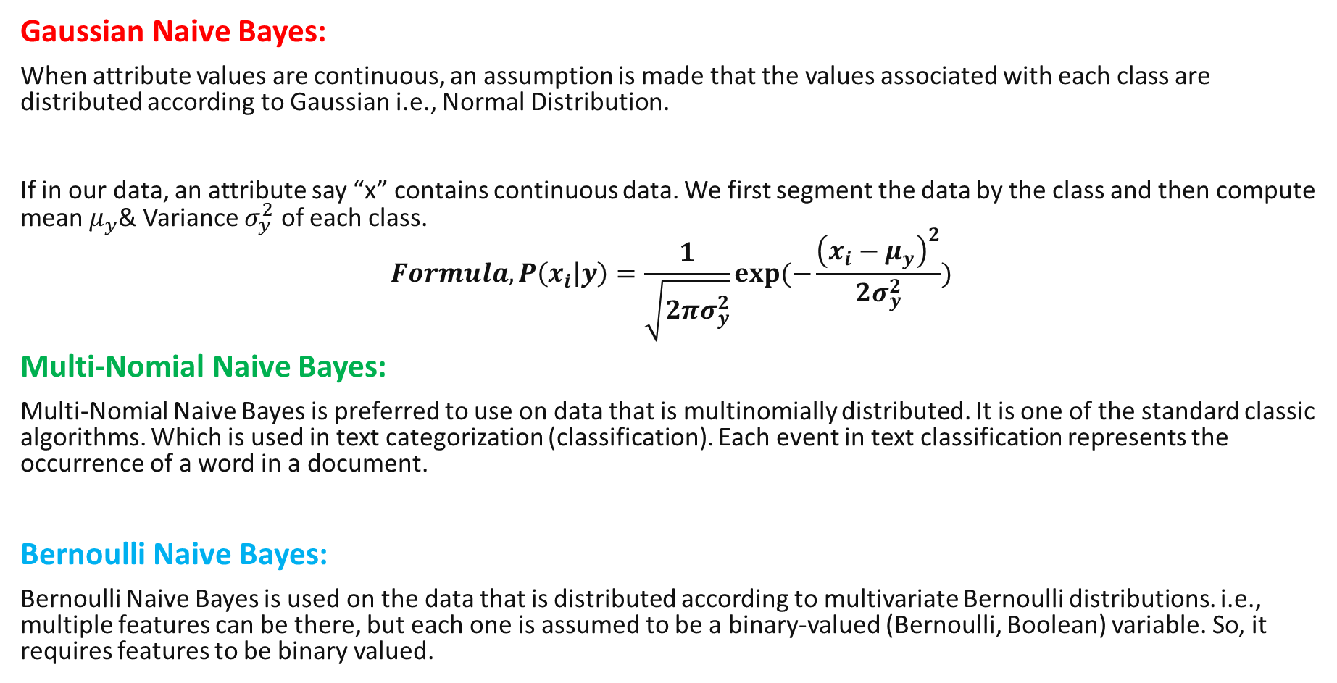
Naïve Bayes
Gaussian Naive Bayes:
When attribute values are continuous, an assumption is made that the values associated with each class are distributed according to Gaussian i.e., Normal Distribution.
If in our data, an attribute say “x” contains continuous data. We first segment the data by the class and then compute mean $μ_{y}$& Variance $σ_{y}^{2}$ of each class.
$$Formula, P\left(x_{i} | y\right)=\frac{1}{\sqrt{2πσ_{y}^{2}}}exp(−\frac{{\left(x_{i}−μ_{y}\right)}^{2}}{2σ_{y}^{2}})$$
Multi-Nomial Naive Bayes:
Multi-Nomial Naive Bayes is preferred to use on data that is multinomially distributed. It is one of the standard classic algorithms. Which is used in text categorization (classification). Each event in text classification represents the occurrence of a word in a document.
Bernoulli Naive Bayes:
Bernoulli Naive Bayes is used on the data that is distributed according to multivariate Bernoulli distributions. i.e., multiple features can be there, but each one is assumed to be a binary-valued (Bernoulli, Boolean) variable. So, it requires features to be binary valued.

Slide 10
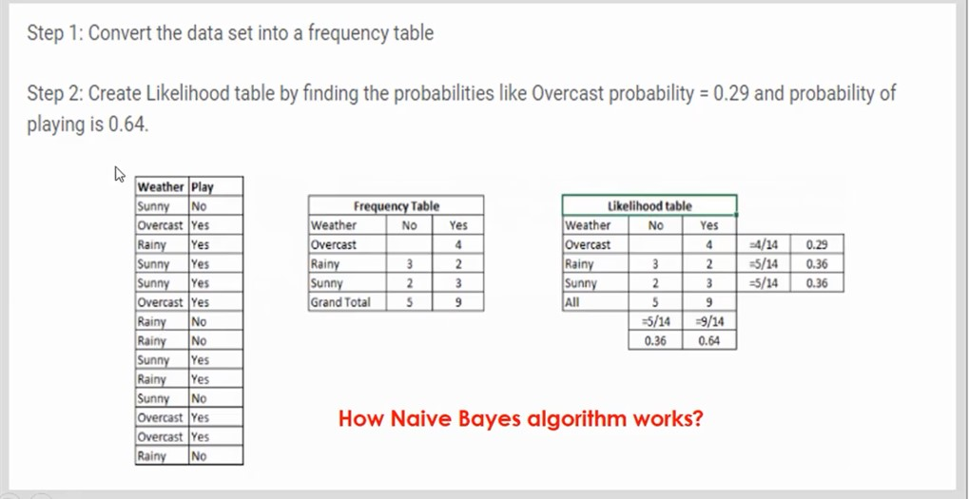
Naïve Bayes

Slide 11
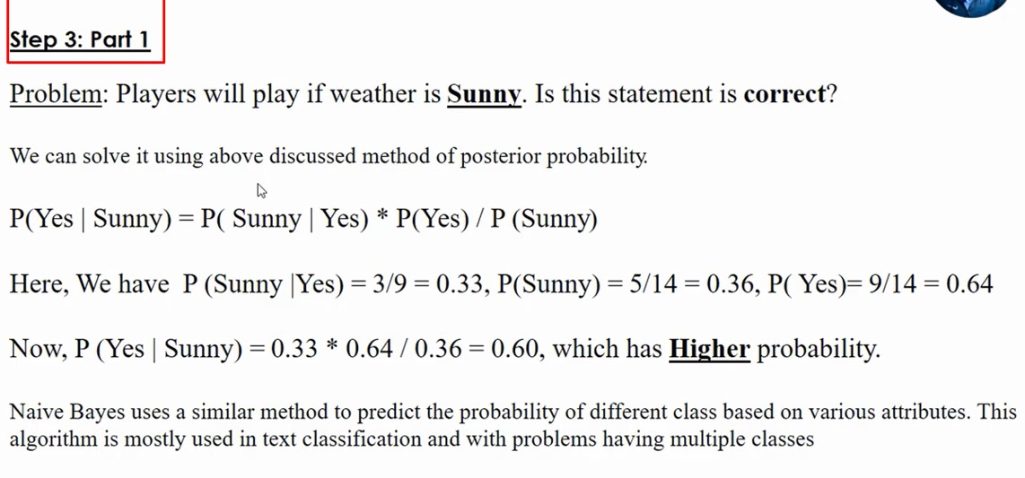
Naïve Bayes

Slide 12
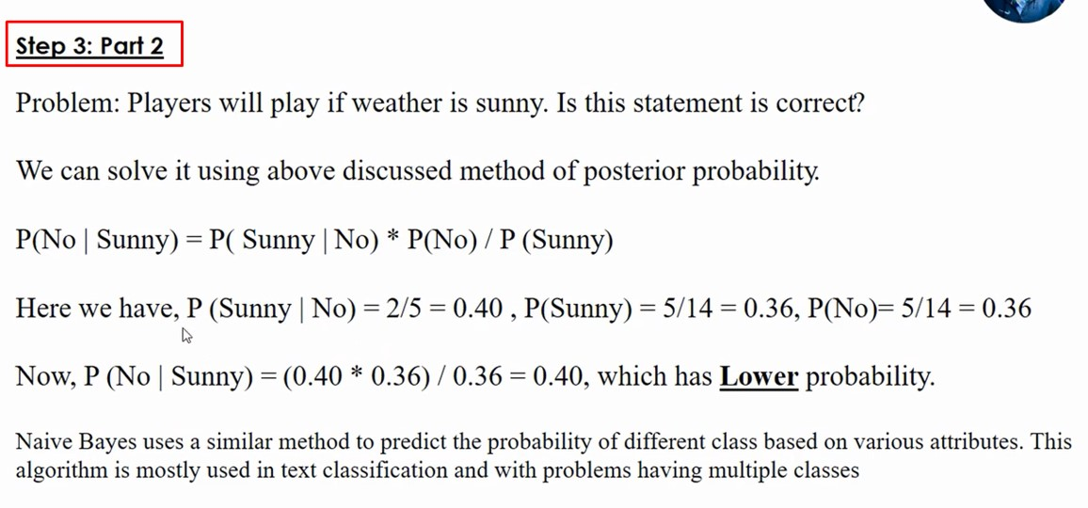
Naïve Bayes

Slide 13
